Slide 1

Symbiosis Skill Hackathon (SSH-2026)
Problem statement – AI Phishing Threat Monitor
PS Domain :- AI/ML and Cyber Security
Team Name: SimonSaysCode
Team Leader -
Shripurna Patil
Members - Ribhav Nale
Rudra Mangate

Slide 2

Problem Statement
Phishing remains one of the most dangerous and widespread cyber threats globally. Studies consistently show that over 90% of cyberattacks begin with phishing emails or deceptive URL’s or messages. Modern attackers don’t hack systems — they hack human psychology. They exploit fear, urgency, trust, and authority to trick users into giving access themselves. This is called social engineering.
Rapid Rise of Multilingual Phishing Attacks
Phishing campaigns are no longer limited to English. Attackers now use AI-powered translation tools and generative AI to create highly convincing phishing messages in regional and local languages. This makes detection significantly harder, especially in diverse countries like India where users communicate in multiple languages.
Traditional detection systems are often trained primarily on English datasets, making them less effective against multilingual or mixed-language (code-switched) phishing content.
Lack of Explainability in Detection
Most existing phishing detection tools simply label content as “Safe” or “Malicious.” However, they do not explain:
Why it is considered phishing
Which words, links, or patterns triggered the alert
What specific risks are involved

Slide 3

No Real-Time Risk Awareness
Users often realize they were attacked after credentials are stolen. There is limited real-time contextual risk scoring that:
Warns users instantly
Shows severity levels
Provides immediate actionable guidance
Cybersecurity tools mostly work silently in the background instead of actively educating the user.

Slide 4

Why This Matters
Financial Loss - Phishing attacks directly lead to financial damage by stealing banking credentials, card details, UPI access, and crypto wallets. Victims often lose money within minutes, and recovery is difficult. For individuals and small businesses, even one successful attack can cause long-term economic instability.
Identity Theft - Attackers use phishing to collect personal data such as login credentials, government IDs, and OTPs. This stolen information can be misused to open fake accounts, take loans, or commit fraud under the victim’s name. Identity theft not only causes financial harm but also damages trust and reputation.
Business Email Compromise (BEC) - Phishing targeting organizations can result in Business Email Compromise, where attackers impersonate executives or vendors. Employees may unknowingly transfer large sums of money or share confidential data. These highly targeted attacks have caused companies to lose millions globally.
Rise of AI-Generated Phishing - With generative AI tools, phishing messages are now more convincing, personalized, and multilingual. Attackers can create error-free emails, mimic writing styles, and even use deepfake voice or video scams. Traditional security filters struggle to detect these advanced threats, increasing the urgency for AI-powered, explainable detection systems.

Slide 5

Detailed Breakdown Of The Solution
URL & Email Scanning Real-time analysis of suspicious URLs and email content using AI models, domain reputation checks, and pattern detection to identify potential phishing attempts instantly.
Probability-Based Risk Scoring Instead of just “Safe” or “Phishing,” the system generates a dynamic probability score (e.g., 82% phishing likelihood) to show the severity level and help users make informed decisions.
Heatmap Visualization Interactive heatmaps highlight suspicious words, phrases, and links inside the message, allowing users to visually understand what triggered the alert.
Phishing Type Detection Automatically classifies attacks into categories such as credential phishing, financial scam, business email compromise (BEC), malware-based phishing, or social engineering.
Prevention & Awareness Guidance Provides clear, actionable recommendations like “Do not click this link,” “Verify sender domain,” or “Report to admin,” helping users learn and avoid future attacks.
Multilingual Threat Detection Supports multiple languages and detects phishing attempts in regional or mixed-language messages, addressing the rise of multilingual AI-generated phishing.
Backend Intelligence Storage Maintains a centralized threat intelligence database to track phishing trends, store flagged domains, and continuously improve detection accuracy through data learning.

Slide 6
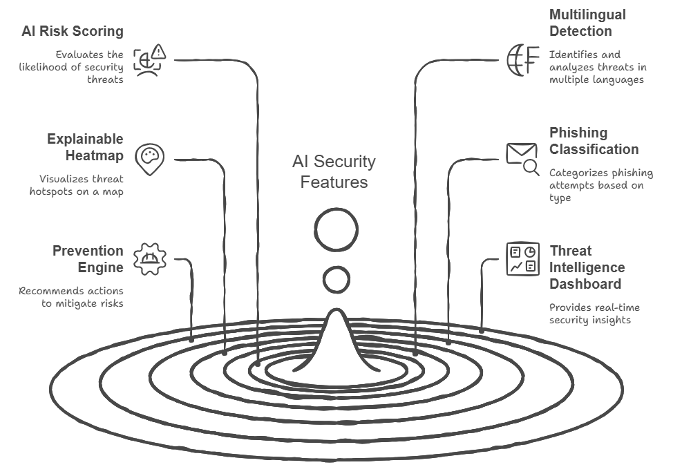
Key Features

Slide 7
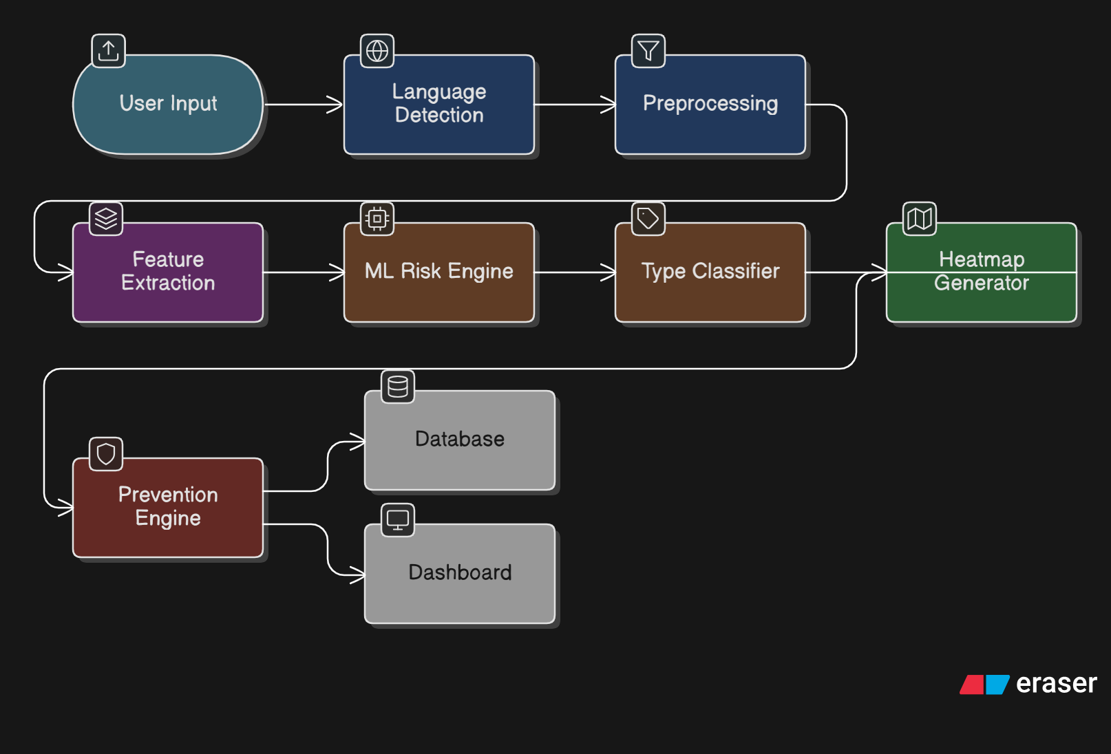
SYSTEM ARCHITECTURE

Slide 8

Technology Stack
Layer | Tech
Frontend | React / HTML CSS JS
Backend | Flask / FastAPI
ML | Scikit-learn
Database | MongoDB
Language Detection | Langdetect
Translation | Google Translate API

Slide 9
SYSTEM ARCHITECTURE
Step 1: Feature Engineering
In the first step, the system extracts important features from URLs and emails to detect phishing patterns. For URLs, it analyzes length, presence of suspicious keywords (like login, verify, secure), usage of IP addresses instead of domain names, and excessive special characters such as “@”, “-”, or “//”. For emails, it detects urgency or threat words (like “Act Now” or “Account Suspended”), counts the number of links, checks sender domain mismatches, and verifies differences in reply-to addresses. These features convert raw data into structured inputs for machine learning.
Step 2: AI Model
The extracted features are then fed into machine learning models such as Random Forest or Logistic Regression, trained on real phishing datasets. The system performs multi-class classification to identify whether the content is safe or malicious and categorize the type of phishing attack. The output includes a risk probability score (0–100%) and the predicted phishing category, demonstrating a strong ML-based threat detection framework.
Step 3 – Explainable AI (Visual Threat Heatmap)
This system does not just detect phishing but also explains why the content is flagged. Suspicious words in emails are highlighted, risky URL segments are color-coded, and high-risk zones are visually marked using a heatmap. This transparency builds user trust and helps security teams quickly understand the threat. Unlike traditional black-box models, our system provides clear, visual justification for every risk score, making it highly interpretable and user-friendly.

Slide 10
SYSTEM ARCHITECTURE
Step 4 – Phishing Type Classification
The system detects and classifies phishing into categories such as Credential Harvesting, Spear Phishing, Clone Phishing, Business Email Compromise, and Malware Delivery. Classification matters because each attack type requires a different response strategy, enabling faster and more targeted action instead of generic warnings.
Step 5 – Prevention Recommendation Engine
Based on the detected phishing type, the system provides actionable security recommendations. For example, in Credential Harvesting cases, it suggests not clicking the link, enabling 2FA, verifying the domain, and reporting the sender. This ensures practical real-world impact beyond just detection.
Step 6 – Threat Intelligence Dashboard
The dashboard visualizes phishing insights using a pie chart for attack types, a bar graph for language distribution, and a timeline graph for trend analysis. Detection data is securely stored in the backend for continuous monitoring and future model improvement.

Slide 11
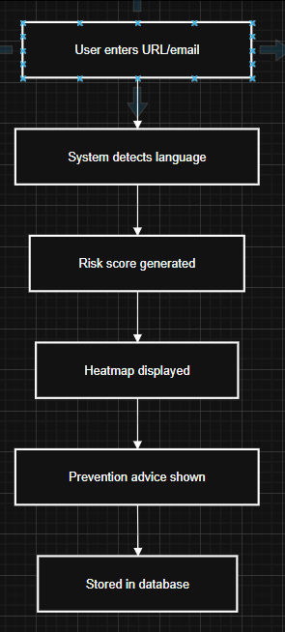
Demo Flow

Slide 12
RESEARCH AND REFERENCES
Title/Reference | Key Findings | Models/Acc. | Year | Link/ID
Phishing Detection using ML-based URL Analysis: Survey | RF best (97.14% acc.); more training data boosts perf.; compares DT/SVM/NB. | RF, DT, SVM, ANN | 2021 | ijert​
Integrated Approach for AI-Generated Phishing URLs ijettjournal+1 | RL + ML for AI-phishing; dynamic features. | Q-Learning + classifiers | 2025 | 99.25% ijettjournal​
AI-Based Phishing Detection for Emails/URLs ​ | Features: keywords, URL length/IP; labeled data. | ML classifiers | 2025 | SSRN papers.ssrn​
Review of ML Techniques for Phishing ​ | Hybrid DL > traditional (98-99%); UCI/PhishTank common. | RF/SVM/CNN/LSTM | 2025 | Trends ijsrtjournal​
Phishing URL Detection using ML (IEEE) | Conference paper on URL ML detection. | Various | 2025 | IEEE ieeexplore.ieee​

Slide 13
FEASIBILITY & VIABILITY
FEASIBILITY ANALYSIS | CHALLENGES & RISKS | MITIGATION STRATEGIES
Core System Implementation Practical Viability: System integrates URL/email input, multilingual detection, ML-based risk scoring, heatmap visualization, and prevention engine using lightweight backend (Flask/FastAPI) and Scikit-learn. | Model Accuracy Risk: False positives or false negatives may reduce trust in system. | Use ensemble ML models (Random Forest + Logistic Regression), cross-validation, and continuous dataset tuning.
Multilingual Detection Supports multiple languages using automatic language detection and translation APIs before phishing classification. | Translation Inaccuracy: Context may be lost during translation affecting prediction accuracy. | Use reliable translation API and combine keyword-based detection with semantic analysis to reduce dependency on translation errors.
Heatmap & Explainable AI Generates visual heatmaps highlighting suspicious words and URL segments for explainable AI output. | Complexity in Visualization: Mapping ML weights into meaningful highlights can be technically challenging. | Use keyword scoring + TF-IDF weights for interpretable highlighting instead of complex deep learning attention models.
Backend Data Storage & Analytics Stores scanned URLs/emails, probability score, phishing type, language, and timestamp in database for trend analysis. | Data Privacy Concerns: Storing phishing content may raise privacy issues. | Store hashed or anonymized data, encrypt database, and avoid storing full sensitive email content.
Real-Time Performance Lightweight ML models ensure real-time risk score generation within seconds. | Processing Latency: Multilingual translation + feature extraction may delay response. | Implement asynchronous processing, caching repeated domains, and optimized feature extraction pipeline.
Scalability Modular architecture allows deployment as web app, browser extension, or enterprise API. | Scalability Limitations: High traffic may overload backend server. | Deploy on scalable cloud platform with load balancing and containerization (Docker).
Security & Compliance System designed with secure API endpoints and encrypted communication. | System Misuse: Attackers may test phishing links using platform. | Rate limiting, CAPTCHA integration, and request logging to prevent abuse.

Slide 14
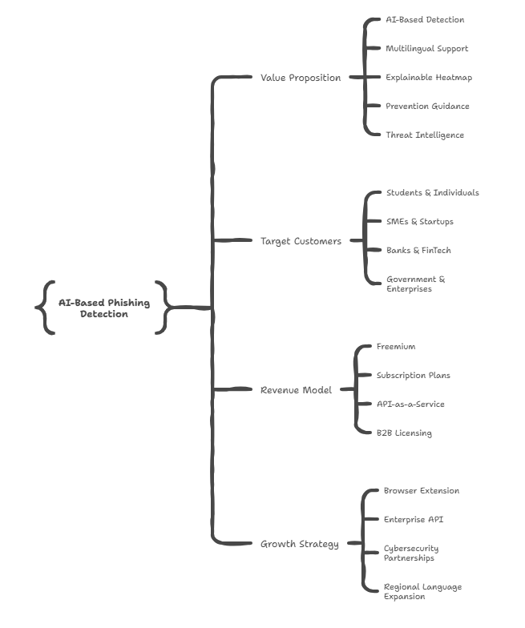
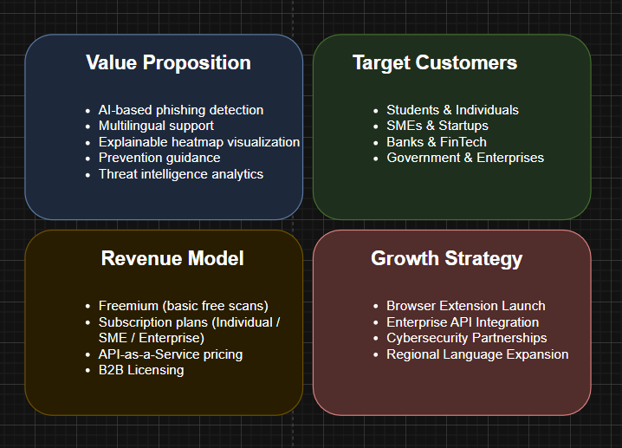
Business Model

Slide 15
Impact of the project
1. Cybersecurity Impact
• Reduces phishing attack success rates through AI-based detection • Detects multilingual and AI-generated phishing attempts • Provides explainable AI via visual heatmaps for transparency • Encourages proactive threat awareness instead of reactive response
2. User Impact
• Empowers non-technical users to recognize phishing threats • Delivers instant, actionable prevention guidance • Builds digital safety confidence and trust • Protects personal data, credentials, and financial assets
3. Business Impact
• Protects SMEs and startups from financial fraud • Minimizes Business Email Compromise (BEC) risks • Offers centralized threat intelligence analytics • Strengthens enterprise cybersecurity posture
4. Societal Impact
• Contributes to a safer digital ecosystem • Supports regional and multilingual internet users • Reduces cybercrime vulnerability at scale • Promotes cybersecurity awareness in developing regions

Slide 16
Conclusion
Phishing is no longer just an email scam — it is a rapidly evolving cyber weapon powered by AI, multilingual manipulation, and advanced social engineering. As attacks become smarter and more personalized, traditional rule-based detection systems are no longer enough.
Our AI-Powered Phishing Threat Monitor goes beyond simple detection by combining:
Intelligent ML-based risk scoring
Explainable AI with visual transparency
Multilingual threat detection
Phishing type classification
Actionable prevention guidance
Real-time threat intelligence analytics
Our solution empowers non-technical users, protects businesses, and strengthens the overall digital ecosystem. It transforms cybersecurity from a background tool into an interactive, transparent, and proactive defense platform.

Slide 17
36-Hour Plan
Hours | Tasks | Assigned | Milestones
0-6 | Setup repo, download dataset, EDA + train basic model. Test on sample URLs. | ML + Dev | Model accuracy >90%; saved pickle.
6-12 | Build feature extractor func. Integrate into Streamlit app (input → predict). Add VirusTotal. | Dev + UI | Local app running scans.
12-18 | UI polish: Dashboard, charts (SHAP for explanations), email scanner stub. | UI + ML | Demo-ready prototype.
18-24 | Test edge cases, fix bugs, add README/demo video. Optimize speed. | All | 99% uptime; mobile-friendly.
24-36 | Deploy, metrics viz (confusion matrix), pitch deck. Rehearse. | All | Live link; judge demo.

